Slide 1
AUTOMATION FOR NETWORK INFRASTRUCTURE
Notes:
Welcome! This is v1.0 of these slides, accurate as of 20-Sep-2017 and are OK for external consumption. Includes Ansible Engine, Networking Add-on, Ansible 2.4 includes and various updates.

Slide 2

MANAGING NETWORKS
HASN’T CHANGED
IN 30 YEARS.

Slide 3
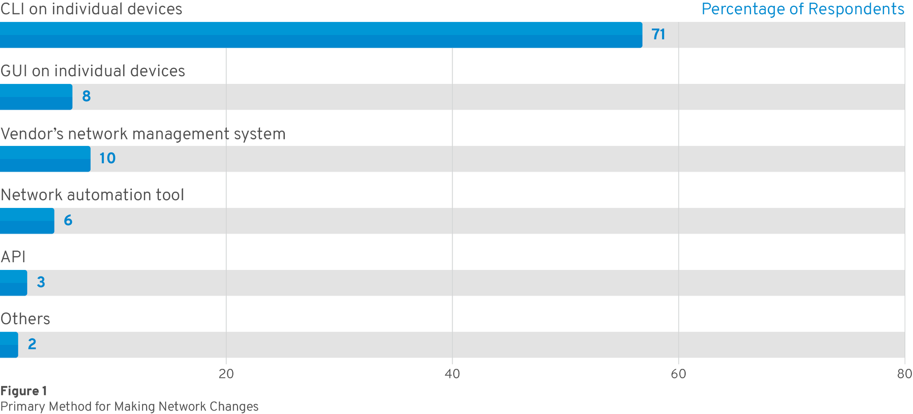
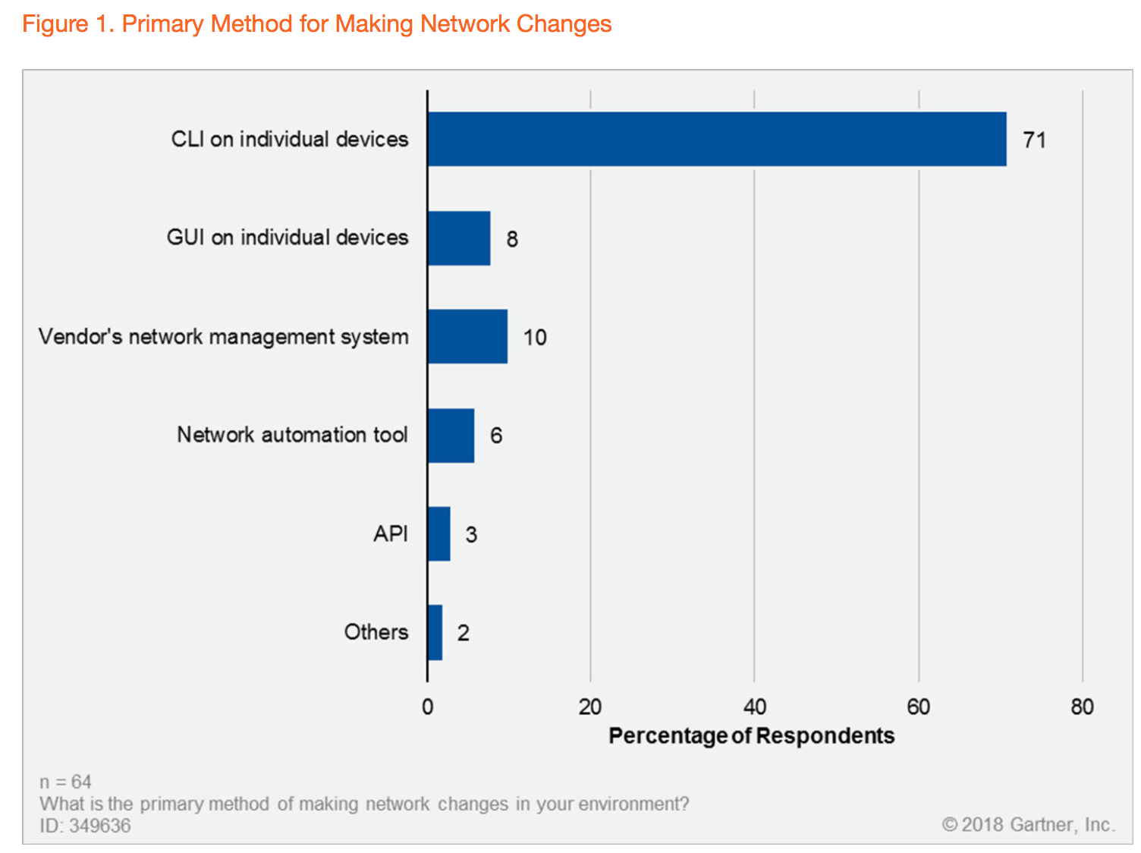
WHAT IS THE PRIMARY METHOD OF MAKING NETWORK CHANGES IN YOUR ENVIRONMENT?
©Gartner Inc., 2018
Source: Gartner, Look Beyond Network Vendors for Network Innovation. January 2018. Gartner ID: G00349636. (n=64)
Notes:
SOURCE: Look Beyond Network Vendors for Network Innovation
Published: 23 January 2018 ID: G00349636 Analyst(s): Andrew Lerner

Slide 4

What is Ansible Automation ?
Ansible Playbooks
The language of automation inside Red Hat - simple and human-readable, but flexible and powerful enough to model any environment.
Red Hat Ansible Engine
Simple, agentless, powerful automation engine utilizing Ansible Playbooks.
Red Hat Ansible Tower
An enterprise framework for controlling, securing, managing and delegating Ansible automation, with a web UI and REST API.
Backed by Red Hat. Fueled by an innovative Open Source community.
Notes:
A playbook is a generic mechanism for an engineer to express desired state, it consists of modules that does the specific action that you would normally do by hand day after day
Ansible engine interprets your playbook as a result of what you’ve described and executes them
Tower is the way to operationalize Ansible in your enterprise, to gain role based access control, audit capabilities, workflows and most importantly Tower is the only way to present a stable API for Tower to talk to. If your legacy application can make an API call out, Tower will sit there ready and waiting to do the work. This allows Ansible to insert itself within an end to end workflow where ansible doesn’t have to be the primary method of insertion ie. Jenkins/ServiceNow
Tower and engine make up the ansible product family:
Engine Includes full support for execution engine, core modules
Tower provides the glue needed to capitalize on Ansible at scale

Slide 5



ANSIBLE NETWORK
OPERATIONS CENTRIC NETWORK AUTOMATION
APPLICATION CENTRIC NETWORK AUTOMATION
CLOUD CENTRIC NETWORK AUTOMATION
Build and push device configurations
Automate tactical operations on network devices
Automate network devices in support of applications
Support direct to device and controller based virtualization
Describe and deploy network connectivity between clouds
Support public/private and/or public/public clouds

Slide 6



Why Ansible?
SIMPLE
POWERFUL
AGENTLESS
Human readable automation
No special coding skills needed
Tasks executed in order
Get productive quickly
Image updates
Configuration management
Compliance
Orchestrate the network lifecycle
Agentless architecture
Uses OpenSSH & WinRM
No agents to exploit or update
More efficient & more secure

Slide 7






Connection Plugins
Python code is executed locally on the control node
NETWORKING
DEVICES
netconf
network_cli
Control Node
httpapi
Python code is copied to the managed node, executed, then removed
LINUX
HOSTS
SSH
Control Node

Slide 8
Example: Backup Config & Run Commands
---
- name: Backup and Troubleshoot
hosts: all
connection: network_cli
tasks:
- name: Backup and Save Running Config
nxos_config:
backup: yes
save_when: always
- name: Run Show Commands
nxos_command:
commands:
- show ip interface brief
- show ip interface description
- show ip route
register: show_commands_out

Slide 9
Example: Configure a Port
---
- hosts: leaf
connection: network_cli
vars:
vlan_id: 20
interface: Ethernet2/1
tasks:
- name: “Configure vlan {{ vlan_id }}“
nxos_vlan:
vlan_id: “{{ vlan_id }}”
- name: “Configure interface {{ interface }}”
nxos_config:
before: “default interface {{ interface }}”
lines:
- description Access Port
- switchport mode access
- “switchport access vlan {{ vlan_id }}”
parents: “interface {{ interface }}”
save_when: modified

Slide 10
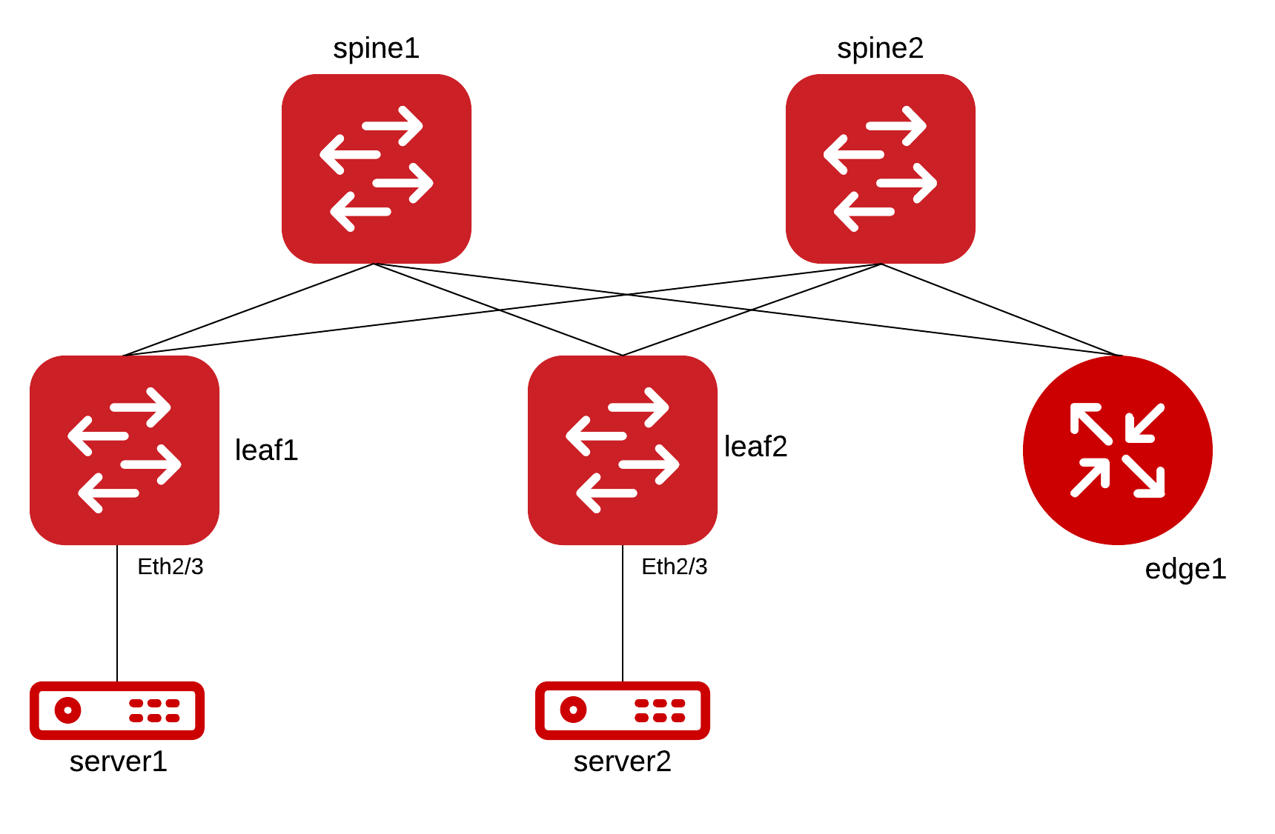

Slide 11
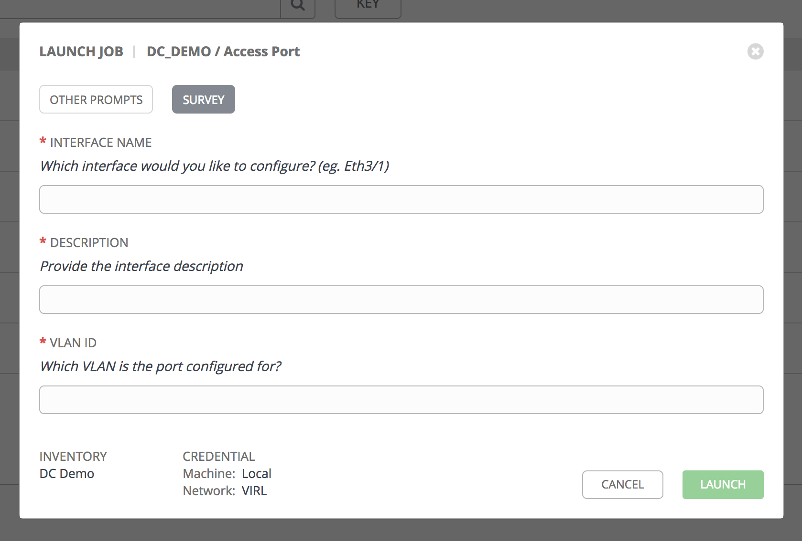
Access Port Survey

Slide 12
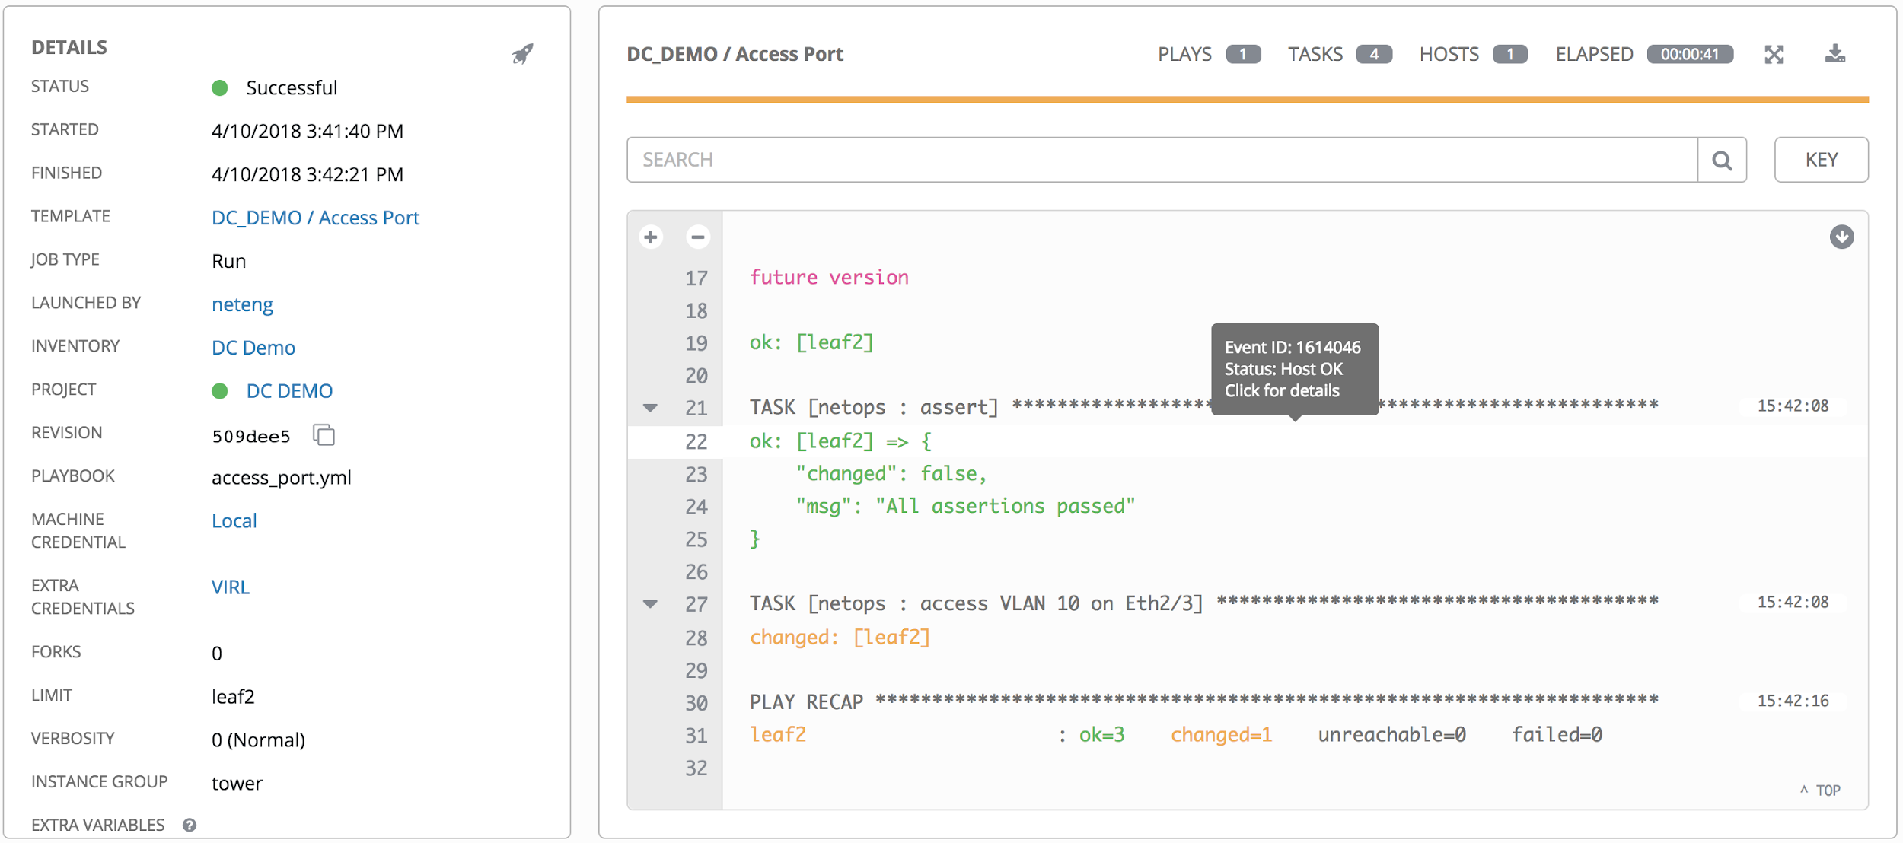
Access Port Output

Slide 13
ANSIBLE MODULES
A10
Apstra
Arista EOS (cli, eAPI), CVP
Aruba Networks
AVI Networks
Big Switch Networks
Cisco ACI, AireOS, ASA, IOS, IOS-XR, NX-OS
Citrix Netscaler
Cumulus Linux
Dell OS6, OS9, OS10
Exoscale
F5 BIG-IP
Fortinet FortIOS
Huawei
Illumos
Juniper Junos
Lenovo
Ordnance
NETCONF
Netvisor
Openswitch
Open vSwitch (OVS)
Palo Alto PAN-OS
Nokia SR OS
VyOS

Slide 14









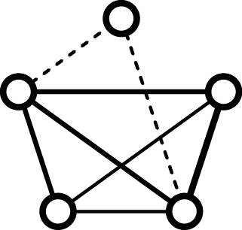



ANSIBLE NETWORK STACK
Architecture
TOWER
NETWORK FUNCTIONS
Operator Focused
Network
Application
Cloud
- Audit
- RBAC
- Credentials
- Inventory
- Web UI
- REST API
- Survey
NETWORK ENGINE
Configuration
Operations
ANSIBLE ENGINE
Network Modules
Connection Plugins
(cli, api, netconf)
Developer Focused
Virtual Devices*
SDN Controllers
Physical Devices

Slide 15
Key/Value Pairs
Abstraction Through Data Models
bgp:
global:
config:
as: 65082
neighbors:
neighbor:
- neighbor_address: 10.11.12.2
config:
peer_group: TST
peer_as: 65086
router bgp 65082
no synchronization
bgp log-neighbor-changes
neighbor 10.11.12.2 remote-as 65086
no auto-summary
bgp {
local-as 65082;
group TST {
peer-as 65086;
neighbor 10.11.12.2;
}
}
Data Model
Vendor-Specific Rendering

Slide 16
How do we go the other way?
Abstraction Through Data Models
bgp:
global:
config:
as: 65082
neighbors:
neighbor:
- neighbor_address: 10.11.12.2
config:
peer_group: TST
peer_as: 65086
router bgp 65082
no synchronization
bgp log-neighbor-changes
neighbor 10.11.12.2 remote-as 65086
no auto-summary
bgp {
local-as 65082;
group TST {
peer-as 65086;
neighbor 10.11.12.2;
}
}
Data Model
Vendor-Specific Rendering

Slide 17
CLI Parser
edge1# sho cdp neighbors detail
----------------------------------------
Device ID:spine1(TB00000000B)
System Name: spine1
Interface address(es):
IPv4 Address: 172.16.1.112
Platform: N7K-C7018, Capabilities: Router Switch
Interface: Ethernet2/1, Port ID (outgoing port): Ethernet2/1
Holdtime: 148 sec
Version:
Cisco Nexus Operating System (NX-OS) Software, Version 7.3(0)D1(1)
Duplex: full
MTU: 1500
Mgmt address(es):
IPv4 Address: 172.16.1.112
----------------------------------------
Device ID:spine2(TB00030000B)
System Name: spine2
...
"neighbors_list": [
{
"local_port": "mgmt0",
"remote_device": "spine1(TB00000000B)",
"mgmt_ip": "172.16.1.112",
"remote_port": "mgmt0"
},
{
"local_port": "Ethernet2/1",
"remote_device": "spine1(TB00000000B)",
"mgmt_ip": "172.16.1.112",
"remote_port": "Ethernet2/2"
},
{
"local_port": "Ethernet2/2",
"remote_device": "spine2(TB00010000B)",
"mgmt_ip": "172.16.1.113",
"remote_port": "Ethernet2/2"
},
...
https://galaxy.ansible.com/ansible-network/network-engine

Slide 18
CLI Parser
edge1# sho cdp neighbors detail
----------------------------------------
Device ID:spine1(TB00000000B)
System Name: spine1
Interface address(es):
IPv4 Address: 172.16.1.112
Platform: N7K-C7018, Capabilities: Router Switch
Interface: Ethernet2/1, Port ID (outgoing port): Ethernet2/1
Holdtime: 148 sec
Version:
Cisco Nexus Operating System (NX-OS) Software, Version 7.3(0)D1(1)
Duplex: full
MTU: 1500
Mgmt address(es):
IPv4 Address: 172.16.1.112
----------------------------------------
Device ID:spine2(TB00030000B)
System Name: spine2
...
---
- name: match sections
pattern_match:
regex: "^-------------------------"
match_all: yes
match_greedy: yes
register: context
- pattern_group:
- name: match device id
pattern_match:
regex: "Device ID:(?P<device_id>.+)"
contents: "{{ item }}"
register: device_id
- name: match local port
pattern_match:
regex: "Interface:.(?P<local_port>.+),"
contents: "{{ item }}"
register: local_port
...
https://galaxy.ansible.com/ansible-network/network-engine

Slide 19
Data Structure
---
pod_interconnects:
Ethernet2/2:
description: default trunk
neighbor: leaf1
Ethernet2/1:
description: default trunk
neighbor: edge1

Slide 20


RED HAT ANSIBLE TOWER
Scale + operationalize your automation
CONTROL
KNOWLEDGE
DELEGATION
RED HAT ANSIBLE ENGINE
Support for your Ansible automation
SIMPLE
POWERFUL
AGENTLESS
FUELED BY AN INNOVATIVE OPEN SOURCE COMMUNITY
<number>
Notes:
<number>

Slide 21
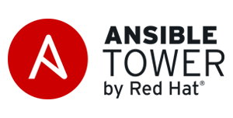
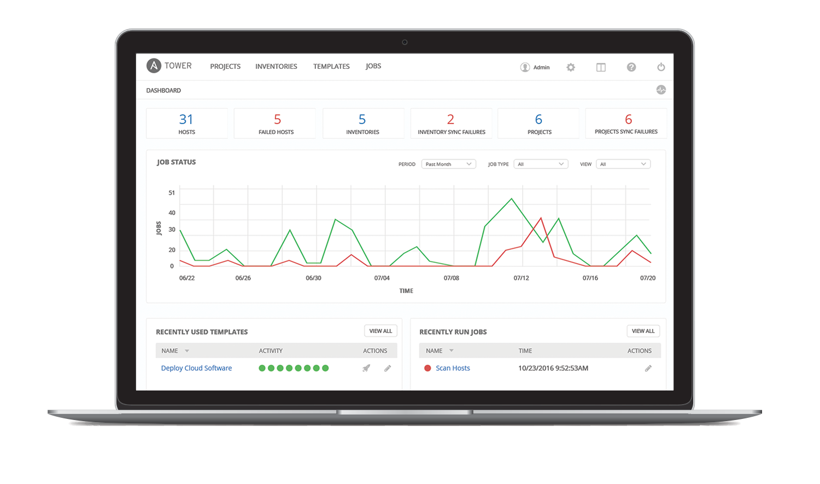
Build & manage dynamic inventory
Roles-Based Access Control
Workflows
Ongoing Compliance
Running Playbooks at Scale
RESTful API
Notes:
For servers and switches alike
choose your data source (CMDB, etc)
Automatic discovery of hardware in parallel
Compare running configs to golden masters on schedules
“Team A can touch the access ports, but they can’t touch the trunk ports.”
-Bootstrap: Trigger device config jobs post Zero Touch Provisioning
<number>

Slide 22



API-Driven Infrastructure
Well Defined, Role Based API
Servers
{|}
Networking
Easily Customizable Back End
Storage
Notes:
<number>

Slide 23








Automate the Enterprise
Customers
SoT
Request
Test Network
Test
Use
API
Develop
Deploy
Configure
Plan
Production Network
Operate
UI
SMEs
Eng
Ops
Operators
Notes:
<number>

Slide 24
RESOURCES
Ansible Networking Homepage:
ansible.com/networking
Would you like to learn Ansible? It’s easy to get started: ansible.com/get-started
Want to learn more?
Videos, webinars, case studies, whitepapers: ansible.com/resources
Network Automation Examples: https://github.com/network-automation/
Ansible Networking Roles: https://github.com/ansible-network/
Github: willtome | Twitter: @willtome
Email: wtome@redhat.com

Slide 25

Notes:
For those customers where Ansible is now core strategic platform for their business, we are releasing Red Hat Ansible Engine.
Red Hat Ansible Engine, a new offering designed to bring the enterprise-grade global support that Red Hat is known for to the popular Ansible automation community project. You can now access the tools/innovations available from Ansible in a hardened, enterprise-grade manner.

Slide 26
NETWORK AUTOMATION PROGRESS
33 Platforms
463 Modules
Declarative Intent
Aggregate Resources
Platform Agnostic
29 Platforms
267 Modules
Persistent Connections
NETCONF Support
17 Platforms
141 Modules
7 Platforms
28 Modules
2.1
May 2016
2.2
Oct 2016
2.3
Apr 2017
2.4
Sep 2017
Notes:
<number>

Slide 27
NETWORK MODULES: DEVICE SUPPORT
A10
Apstra
Arista EOS (cli, eAPI), CVP
Aruba Networks
AVI Networks
Big Switch Networks
Cisco ACI, AireOS, ASA, IOS, IOS-XR, NX-OS
Citrix Netscaler
Cumulus Linux
Dell OS6, OS9, OS10
Exoscale
F5 BIG-IP
Fortinet FortIOS
Huawei
Illumos
Juniper Junos
Lenovo
Ordnance
NETCONF
Netvisor
Openswitch
Open vSwitch (OVS)
Palo Alto PAN-OS
Nokia SR OS
VyOS
Notes:
“Platforms” are simply network operating systems in the Ansible enablement space. As of Ansible 2.4, there are 33 networking platforms enabled.
<number>

Slide 28


Control Node
Managed Network Devices
Inventory
Network Element
Playbook
SSH
Network Element
SSH, API
NETCONF
Modules
Network Element
Modules: Handles execution of remote system commands
Control Node: Any client system (server, laptop, VM) running Linux or Mac OSX
Managed Nodes (Inventory):
A collection of endpoints being managed via SSH or API.
Notes:
So how does it all work behind the scenes? Managing network devices is a little bit different compared to servers, since there’s no runtime environment and filesystem available for Ansible to use on the network device. Therefore, most all the work must be done by the Ansible module specific to the network hardware. In a server environment, when an Ansible playbook is run, all the files required are coped to the device temp directory, executed, and then all temporary files are erased. On network devices, the module sends “virtual” human CLI commands, and then waits for standard output back from the network device to display back to the user via the playbook. Given there’s nothing executed locally on the network device, modules are extremely important for network devices to be enabled with Ansible.
Modules: required for most networking
Control Node: Requires: Python 2.6 or greater
Inventory examples: Switches, Routers, Firewalls, Servers, VMs, Containers, Cloud Devices, etc.
<number>

Slide 29








CMDB
PUBLIC / PRIVATE CLOUD
PUBLIC / PRIVATE CLOUD
ANSIBLE AUTOMATION ENGINE
USERS
INVENTORY
CLI
HOSTS
MODULES
PLUGINS
NETWORK DEVICES
ANSIBLE PLAYBOOK
CORE
NETWORK
COMMUNITY
Notes:
So how does Ansible actually work?
The Users make everything possible — they can be Network Engineers or Network Operators that write the Ansible playbooks and then feed them into the Ansible Automation Engine for execution.
The Automation Engine contains four key subsystems:
Inventory – A collection of endpoints being managed. For example they can be switches, firewalls, routers, servers, virtual machines, cloud devices, containers, etc. As long as the instances can be connected to via an API, SSH, or WinRM, they can be managed by Ansible’s inventory.
Modules – An integral piece for network infrastructure enablement – modules control system resources, services, packages, files, or handle executing system commands. Not a lot of significant changes were made to the underlying Ansible code to enable networking devices, but instead focus was put on enabling folks like Arista to leverage platform-specific features and functionality through the development of their Ansible modules. Currently Ansible includes over 750 modules and of those over 175 are network-related. There are thousands more available in the community. Whatever you’re trying to automate, changes are that there are already modules available for use today.
API – This is the internal python API for Ansible, not to be confused with the RESTful API with Tower, which is separate. The internal Ansible API is used for the support of the Ansible command line tools, and not intended for direct consumption.
Plugins – Pieces of code that augment Ansible’s core functionality. For example: Action plugins are front ends to modules, Strategy plugins control the flow of a play and execution logic, Connections plugins define how to communicate with inventory hosts like WinRM, SSH, Docker exec. There are many more and you can easily write your own.
<number>

Slide 30
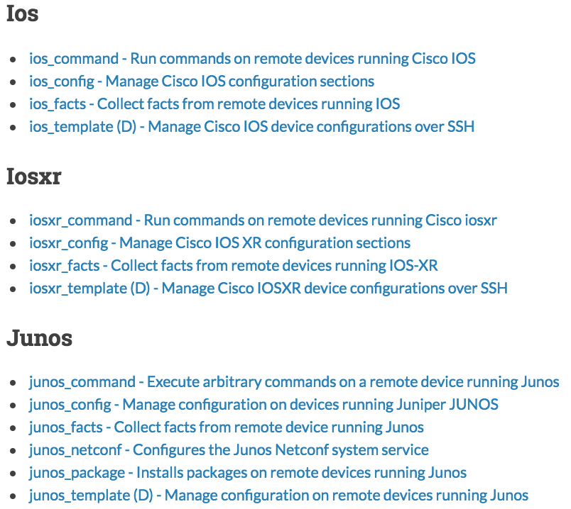
NETWORK MODULES: BASIC
*_command:
Run command get/use output
*_config:
Make a change to the config with context
*_facts:
Get information (e.g. OS version, interfaces, etc.)
*_template (D)
Deploy Template: Apply J2 Template. Deprecated in favor of *_config commands
Notes:
<number>

Slide 31
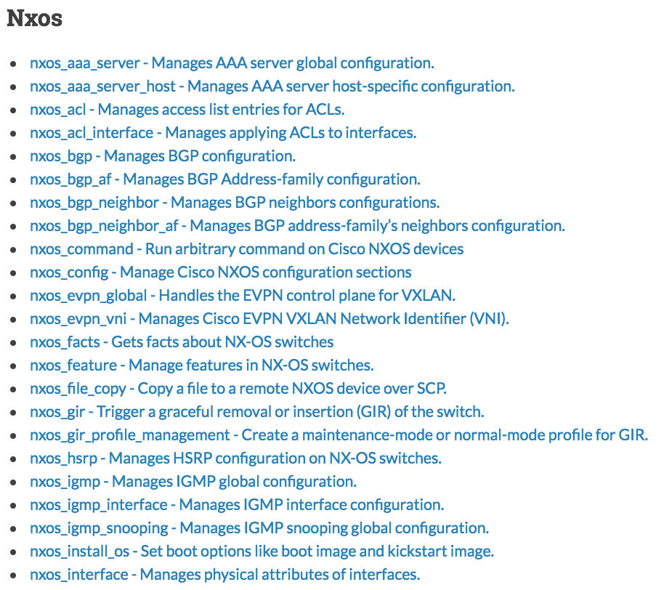
NETWORK MODULES: FUNCTION BASED
Commands that provide a particular function instead of just running command.
Examples:
AAA
NTP
HSRP
Vendor-specific tasks
Notes:
<number>

Slide 32
Configuration Backup
---
- name: Backup and Troubleshoot
hosts: all
connection: local
tasks:
- name: Backup and Save Running Config
nxos_config:
backup: yes
save_when: always
- name: Run Show Commands
nxos_command:
commands:
- show ip interface brief
- show ip interface description
- show ip route
register: show_commands_out
Notes:
<number>

Slide 33
Configure a Port
---
- hosts: leaf
connection: local
vars:
vlan_id: 20
interface: Ethernet2/1
tasks:
- name: “Configure vlan {{ vlan_id }}“
nxos_vlan:
vlan_id: “{{ vlan_id }}”
- name: “Configure interface {{ interface }}”
nxos_config:
before: “default interface {{ interface }}”
lines:
- description Access Port
- switchport mode access
- “switchport access vlan {{ vlan_id }}”
parents: “interface {{ interface }}”
save_when: modified
Notes:
<number>

Slide 34
Deploy a VLAN
---
- hosts: leaf
connection: local
vars:
vlan_id: 20
interface: Ethernet2/1
tasks:
- name: “Configure vlan {{ vlan_id }}“
nxos_vlan:
vlan_id: “{{ vlan_id }}”
- name: “Configure interface {{ interface }}”
nxos_config:
before: “default interface {{ interface }}”
lines:
- description Access Port
- switchport mode access
- “switchport access vlan {{ vlan_id }}”
parents: “interface {{ interface }}”
save_when: modified
Notes:
<number>

Slide 35


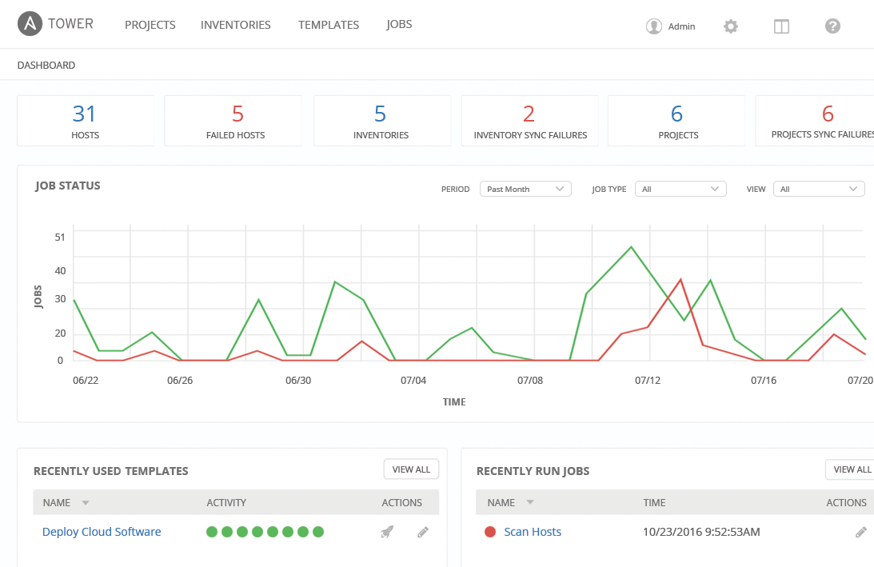
SCALE
MANAGE
CONNECT
Notes:
SCALE
INSTANCE GROUPS, Guarantee automation capacity for user organizations
ISOLATED NODES, Move execution to remote and/or partially-disconnected networks
FACT UPDATES, Re-vamped fact scanning and caching, and they directly access from Playbook runs
MANAGE
SMART INVENTORY GROUPS, from any custom set of facts.
DEEPER RED HAT INSIGHTS INTEGRATION, predictive analytics
SCM-CONTROLLED INVENTORY
CONNECT
PLUGGABLE CREDENTIALS
Tower credentials can source secrets from other systems (i.e. CyberArk, etc.), and they are accessible from custom inventory scripts
NAMED URL ACCESS, Access Jobs via names in API, rather than numbers, which unifies management of numerous Tower systems

Slide 36
RED HAT ANSIBLE TOWER
Scale + operationalize your automation
CONTROL
KNOWLEDGE
DELEGATION
RED HAT ANSIBLE ENGINE
Support for your Ansible automation
SIMPLE
POWERFUL
AGENTLESS
FUELED BY AN INNOVATIVE OPEN SOURCE COMMUNITY
Notes:
Ansible Tower customers can add an Ansible Engine subscription to their Ansible Tower subscription at any time to gain support for the underlying Ansible automation that powers Ansible Tower
Engine - helps you automate
Tower - enables you to operationalize it
Now please help me welcome
Peter Sprygada, who I like to call my Ansible Networking CTO, who will discuss now Ansible is changing the game in networking.

Slide 37
Build & manage dynamic inventory
Roles-Based Access Control
Workflows
Ongoing Compliance
Running Playbooks at Scale
RESTful API
Notes:
For servers and switches alike
choose your data source (CMDB, etc)
Automatic discovery of hardware in parallel
Compare running configs to golden masters on schedules
“Team A can touch the access ports, but they can’t touch the trunk ports.”
-Bootstrap: Trigger device config jobs post Zero Touch Provisioning
<number>

Slide 38
API-Driven Infrastructure
Well Defined, Role Based API
Servers
{|}
Networking
Easily Customizable Back End
Storage
Notes:
<number>

Slide 39
Automate the Enterprise, not just Humans
Customers
SoT
Request
Test Network
Test
Use
API
Develop
Deploy
Configure
Plan
Production Network
Operate
UI
SMEs
Dev
Ops
Operators
Notes:
<number>

Slide 40



API DRIVEN INFRASTRUCTURE
Well Defined Role Based API
Servers
{|}
Networking
Easily Customizable Back End
Reputation
Monitoring
Storage
Notes:
<number>

Slide 41
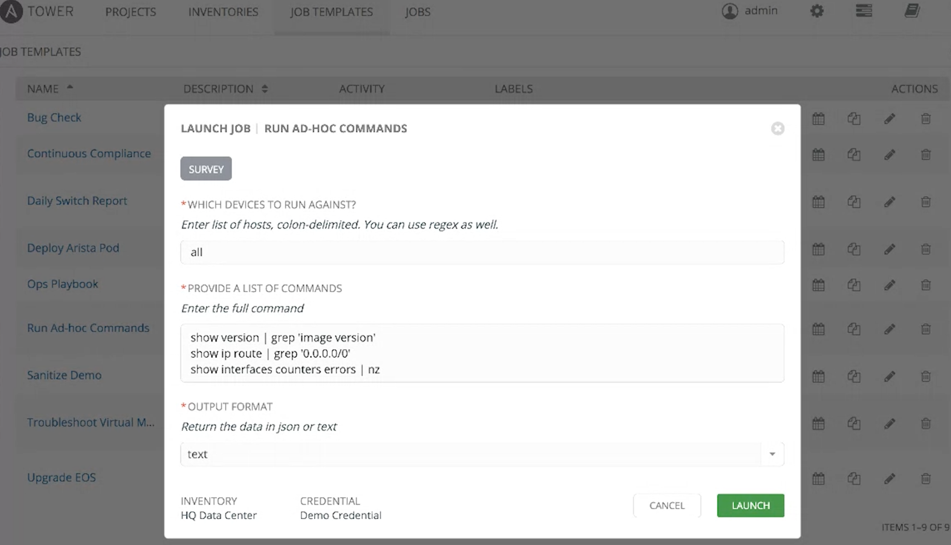
TOWER EXAMPLES (ARISTA)
Notes:
<number>

Slide 42
RESOURCES
Ansible Networking Homepage:
ansible.com/networking
Download Ansible 2.4:
releases.ansible.com/ansible/
Evaluate Ansible Tower:
ansible.com/tower-trial/
Email: gettingstarted@ansible.com
Join the Community
Users list: ansible-project
Development list: ansible-devel
Announcement list: ansible-announce (read only)
irc.freenode.net: #ansible
slack.networktocode.com: #ansible
Notes:
<number>

Slide 43
ANSIBLE NETWORK STRATEGY
Hybrid Cloud
Network Interconnect
- Unified Network Operations, Any Cloud / Any Model Connectivity
Data Center Fabric Automation
- Automated Deployment, Intent-based Design, Drift Protection
Physical Network
State Validation
- Build Management, Operational Readiness, Network Compliance
Stateful Validation
Configuration Templates
Dynamic Resource Pools
Topology Inventory
Declarative Intent
Device Operations
Aggregate Resources
Platform Modules
NETWORK AUTOMATION
ADD-ON
Network Modules

Slide 44







WHY ANSIBLE TOWER FOR NETWORKS
….
ANSIBLE CLI & CI SYSTEMS
ADMINS
ANSIBLE PLAYBOOKS
ANSIBLE TOWER
ROLE-BASED ACCESS CONTROL
KNOWLEDGE & VISIBILITY
SCHEDULED & CENTRALIZED JOBS
SIMPLE USER INTERFACE
TOWER API
USERS
ANSIBLE
OPEN SOURCE MODULE LIBRARY
PLUGINS
PYTHON CODEBASE
TRANSPORT SSH, WINRM, ETC.
AUTOMATE YOUR ENTERPRISE
INFRASTRUCTURE
LINUX, WINDOWS,
UNIX …
NETWORKS
ARISTA, CISCO, JUNIPER …
CONTAINERS
DOCKER,
LXC …
CLOUD
AWS, GOOGLE CLOUD, AZURE …
SERVICES
DATABASES,
LOGGING, SOURCE CONTROL MANAGEMENT…
USE CASES
PROVISIONING
CONFIGURATION
MANAGEMENT
APP DEPLOYMENT
CONTINUOUS DELIVERY
SECURITY & COMPLIANCE
ORCHESTRATION
Notes:
For servers and switches alike
choose your data source (CMDB, etc)
Automatic discovery of hardware in parallel
Compare running configs to golden masters on schedules
“Team A can touch the access ports, but they can’t touch the trunk ports.”
-Bootstrap: Trigger device config jobs post Zero Touch Provisioning
<number>

Slide 45
NETWORK MODULES: BASIC
*_command:
Run command get/use output
*_config:
Make a change to the config with context
*_facts:
Get information (e.g. OS version, interfaces, etc.)
*_template (D)
Deploy Template: Apply J2 Template. Deprecated in favor of *_config commands
Notes:
<number>

Slide 46
NETWORK MODULES: FUNCTION BASED
Commands that provide a particular function instead of just running command.
Examples:
AAA
NTP
HSRP
Vendor-specific tasks
Notes:
<number>

Slide 47

MANAGING NETWORKS
HASN’T CHANGED
IN 30 YEARS.

Slide 48
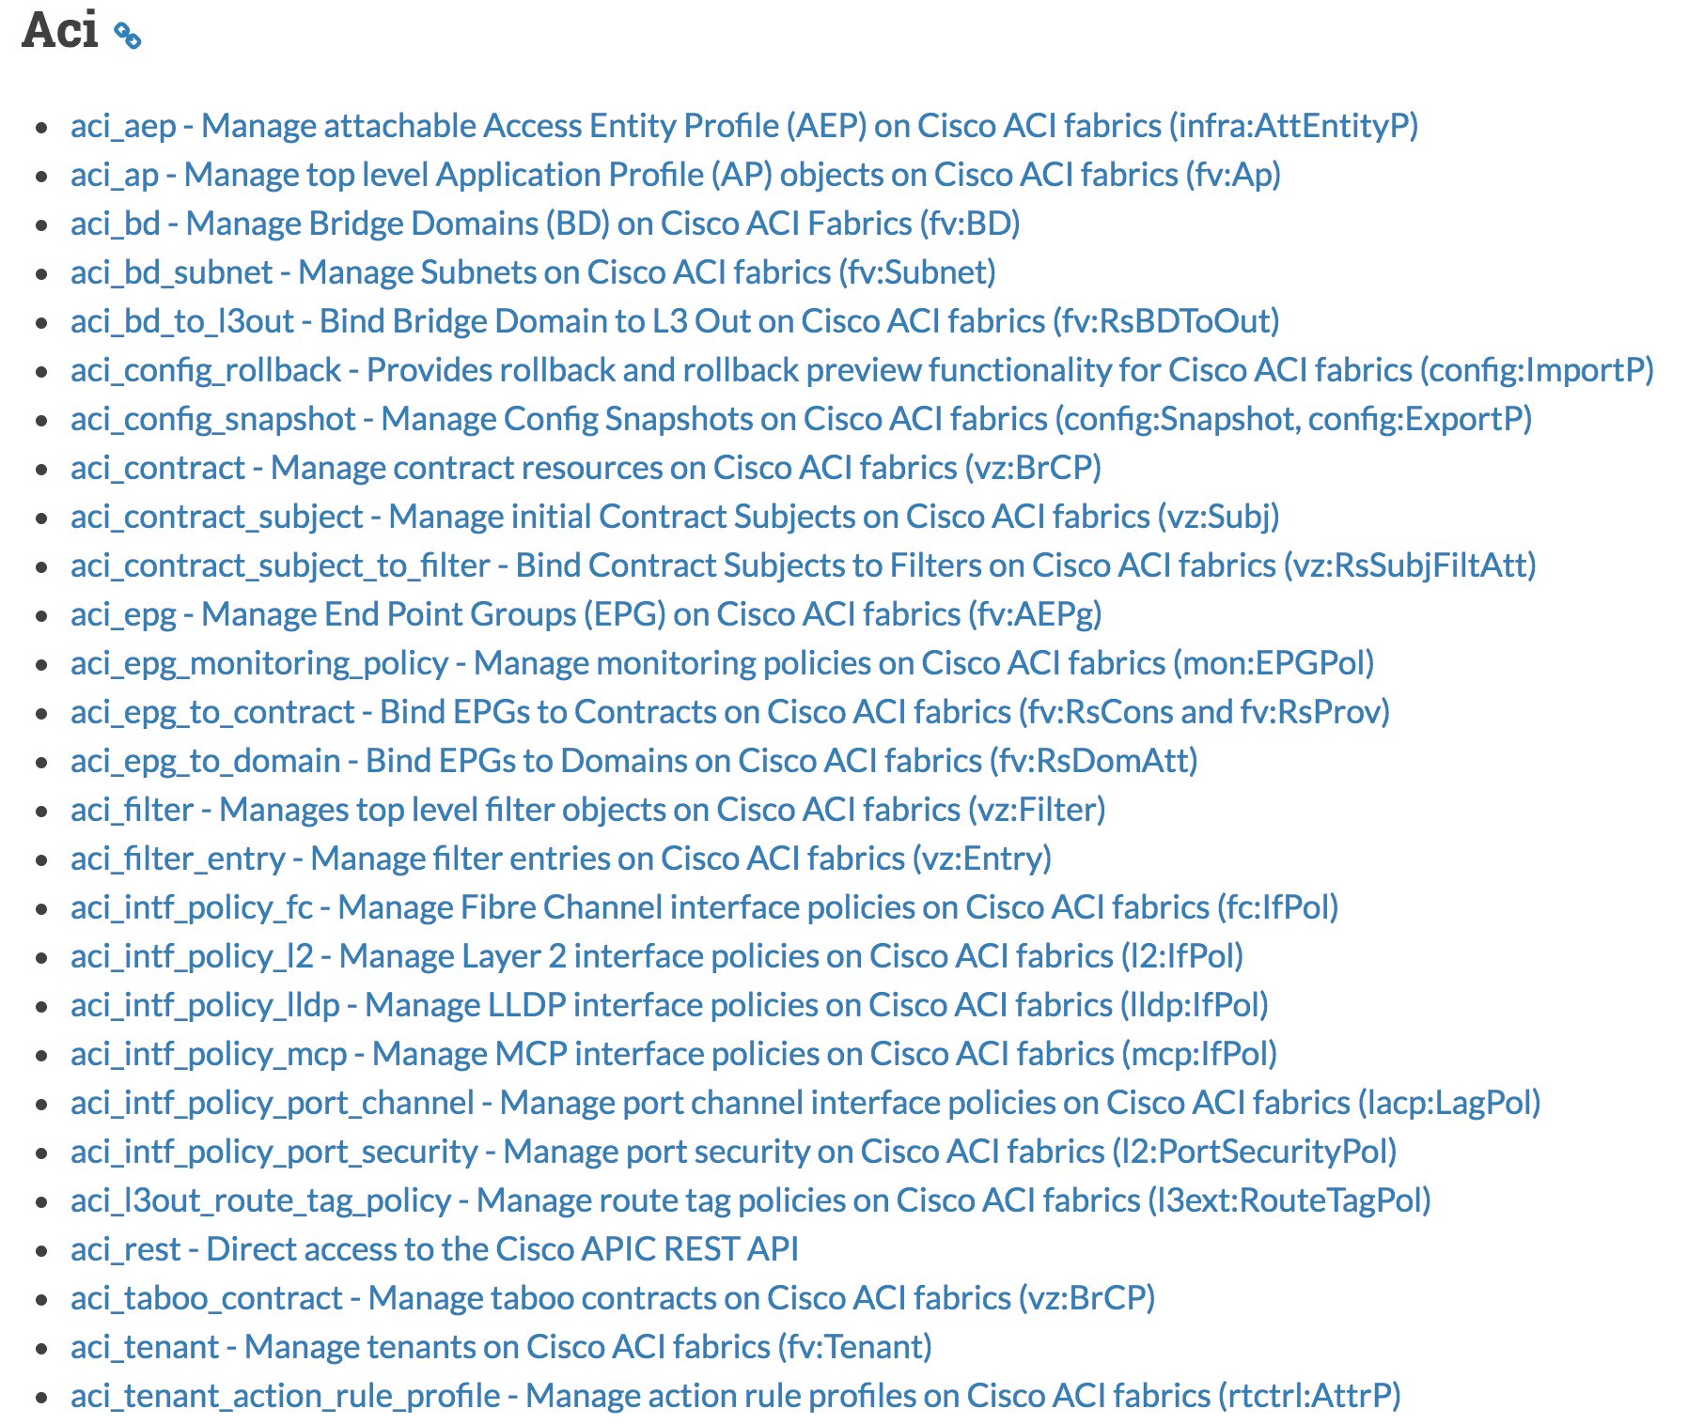
Network Modules: Cisco ACI
Modules are the tools in the toolkit and the building blocks of your playbook
aci_rest:
Run API Commands. Use exported xml from ACI
- name: Add a new tenant aci_tenant: hostname: apic tenant: production description: Production tenant state: present
Notes:
<number>

Slide 49
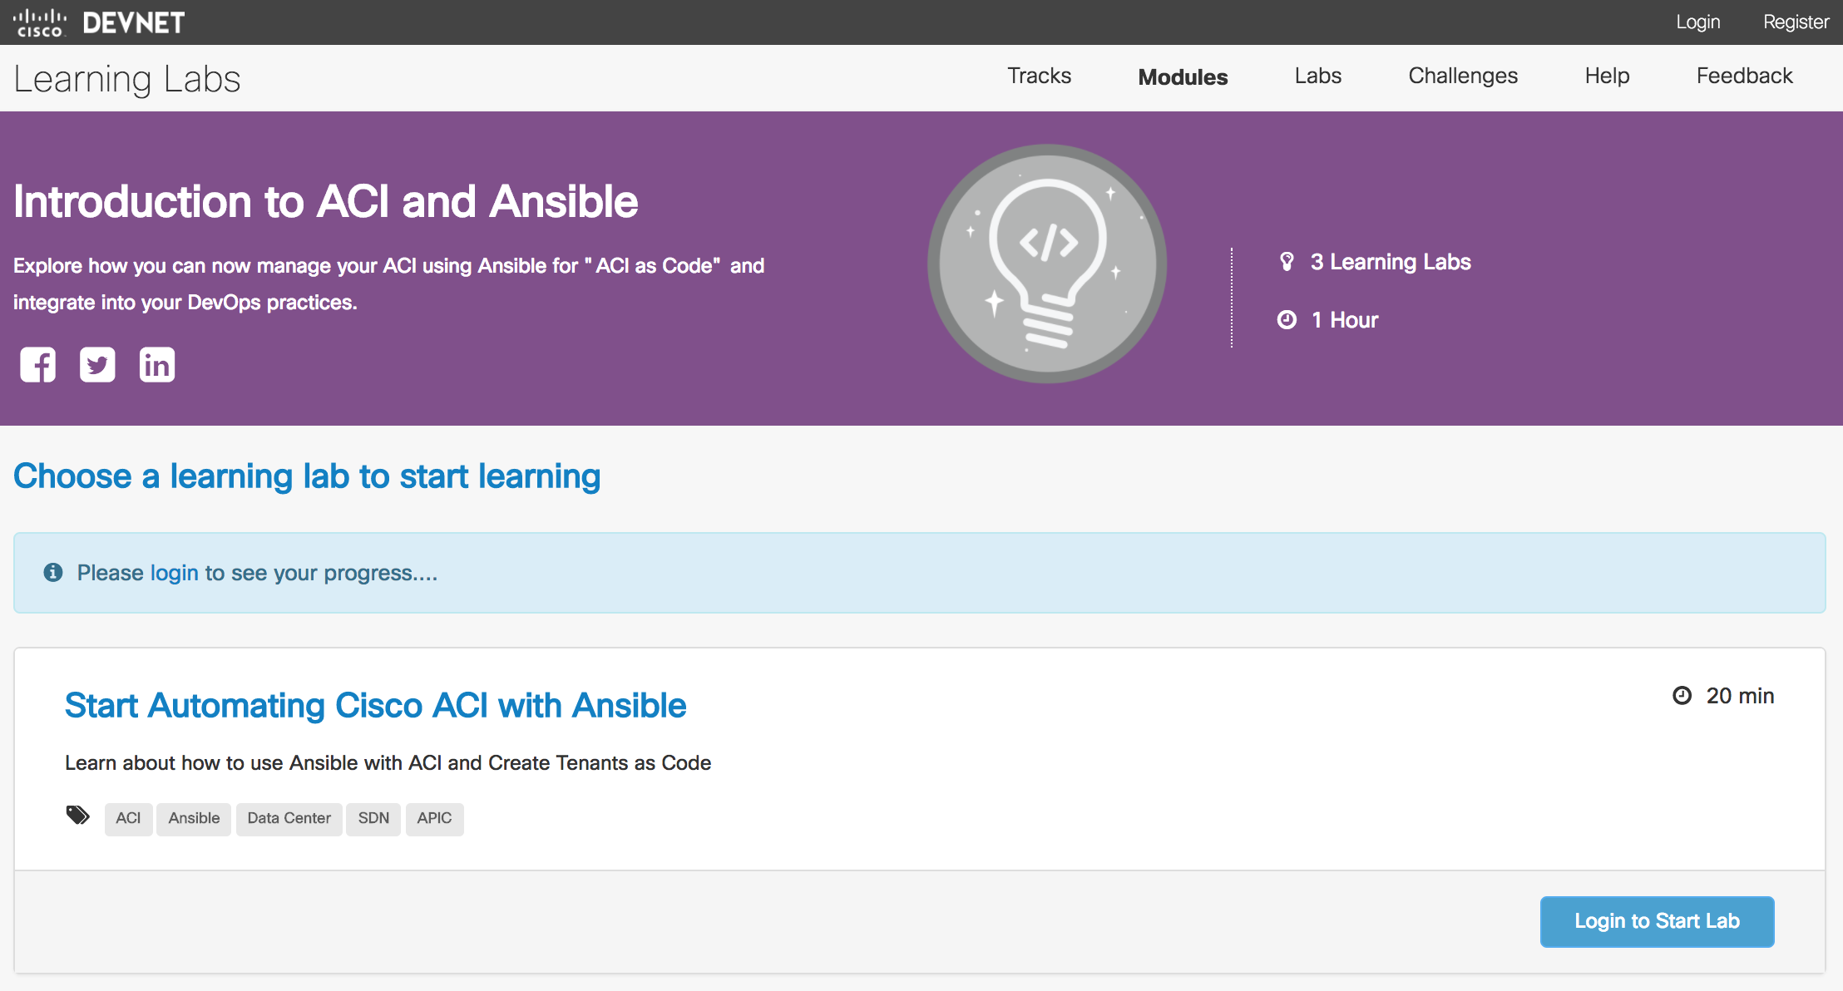
Getting Started with Ansible + ACI
https://learninglabs.cisco.com/modules/ansible-aci-intro
Notes:
<number>

